Slide 1
UTA WATER POLO SPORT CLUB WEBSITE
CSE-3311-TEAM 2, 2017
Dara Krang, Gasser Montaser, Nohemi Gonzalez Lopez

Slide 2
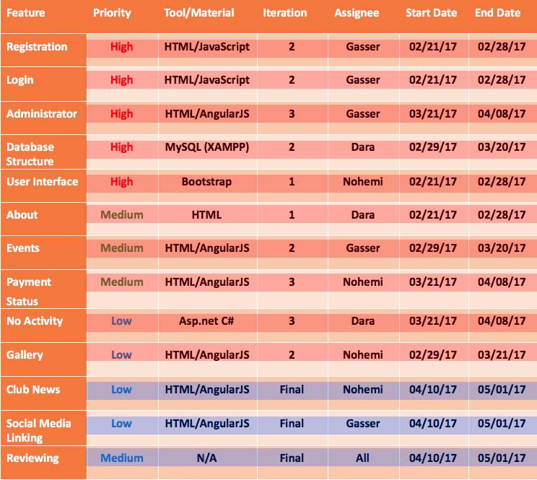
Project Plan
2

Slide 3
Created Players event page to signup for events
Removed Like Button From Images
Removed Register Button From guest view
Updated Home page for Guest
Added header with contact information
Polished the website.

Slide 4
Constrains
Coordinator request changes on website
P=05% E= 1 hours
Time
P=20% E= 4 hours

Slide 5
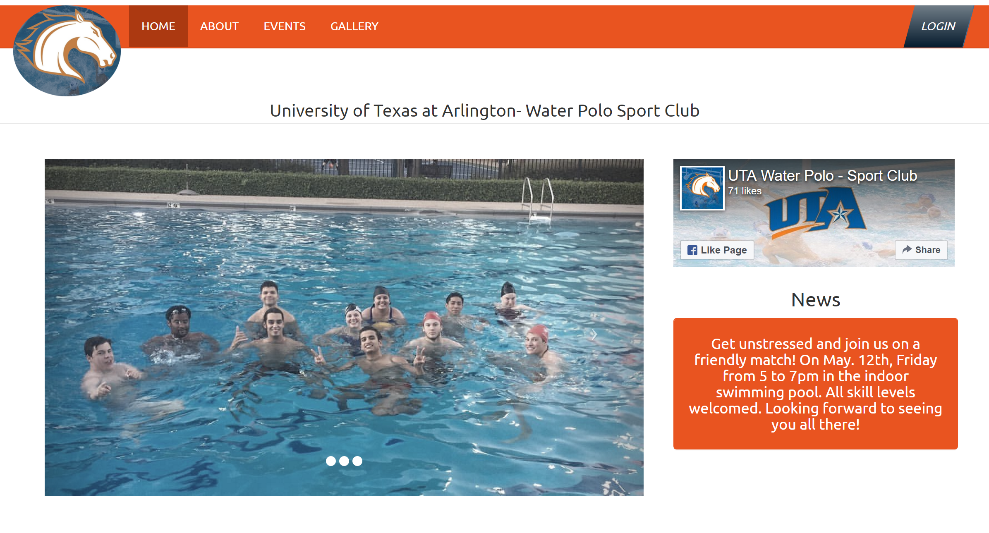

Slide 6
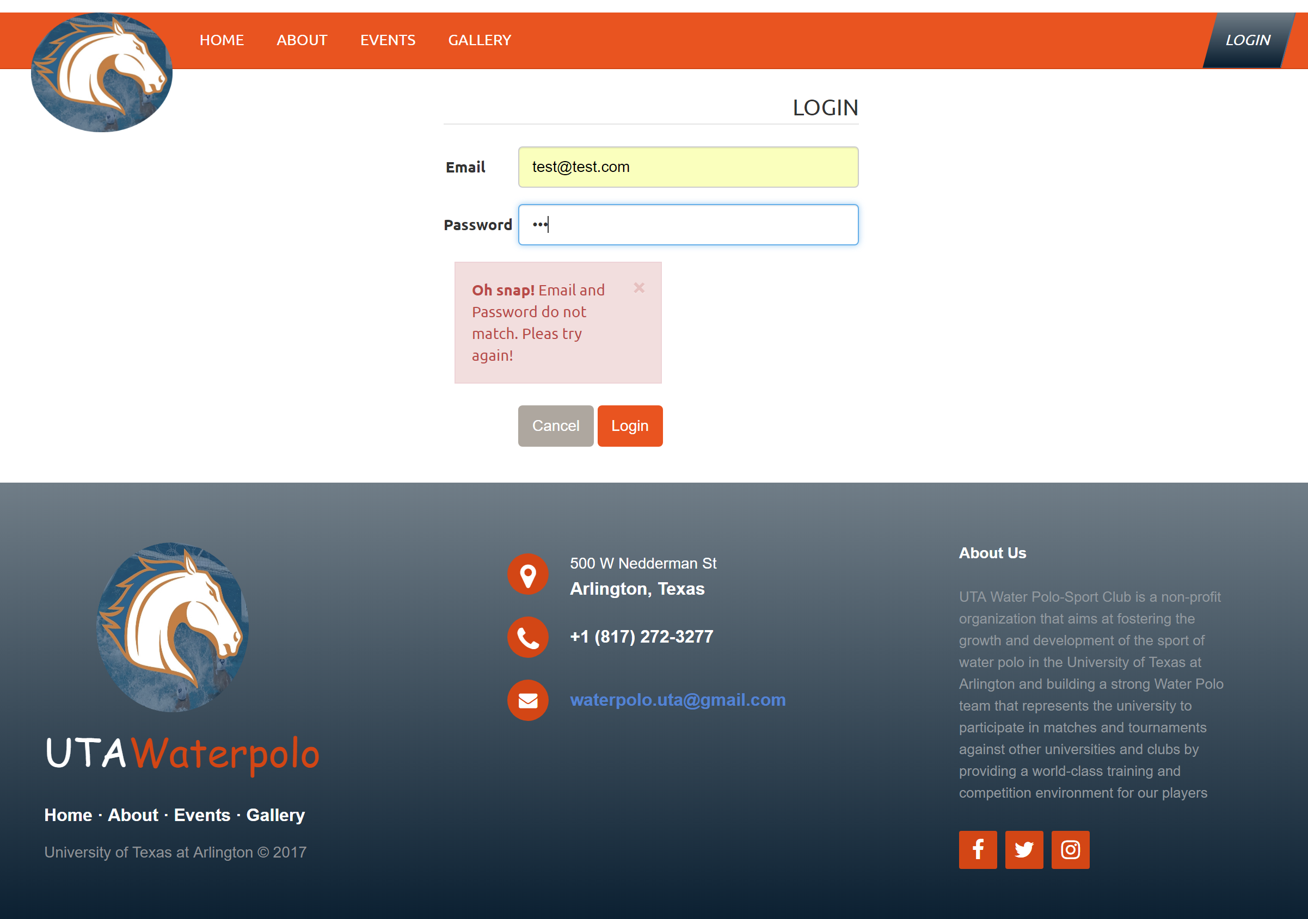

Slide 7
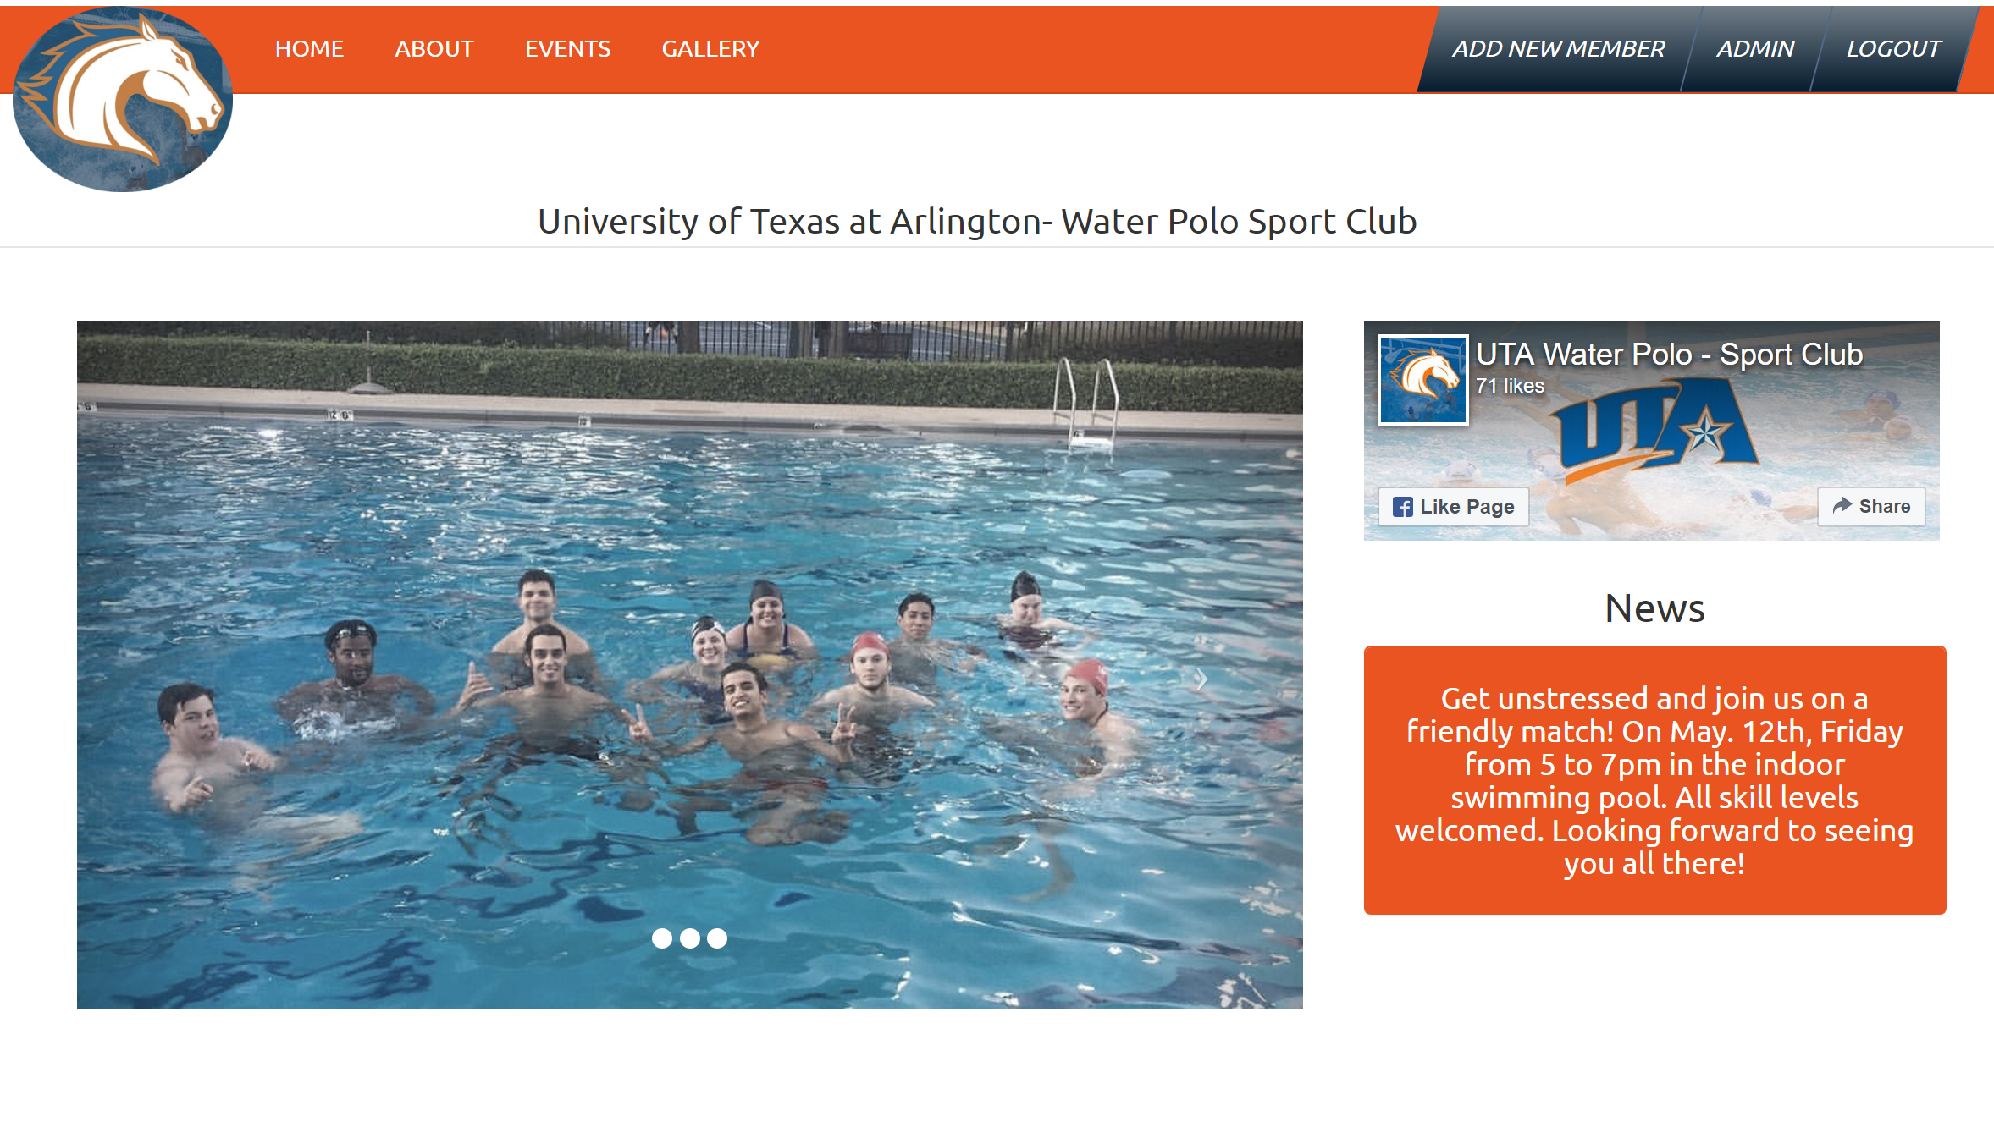

Slide 8
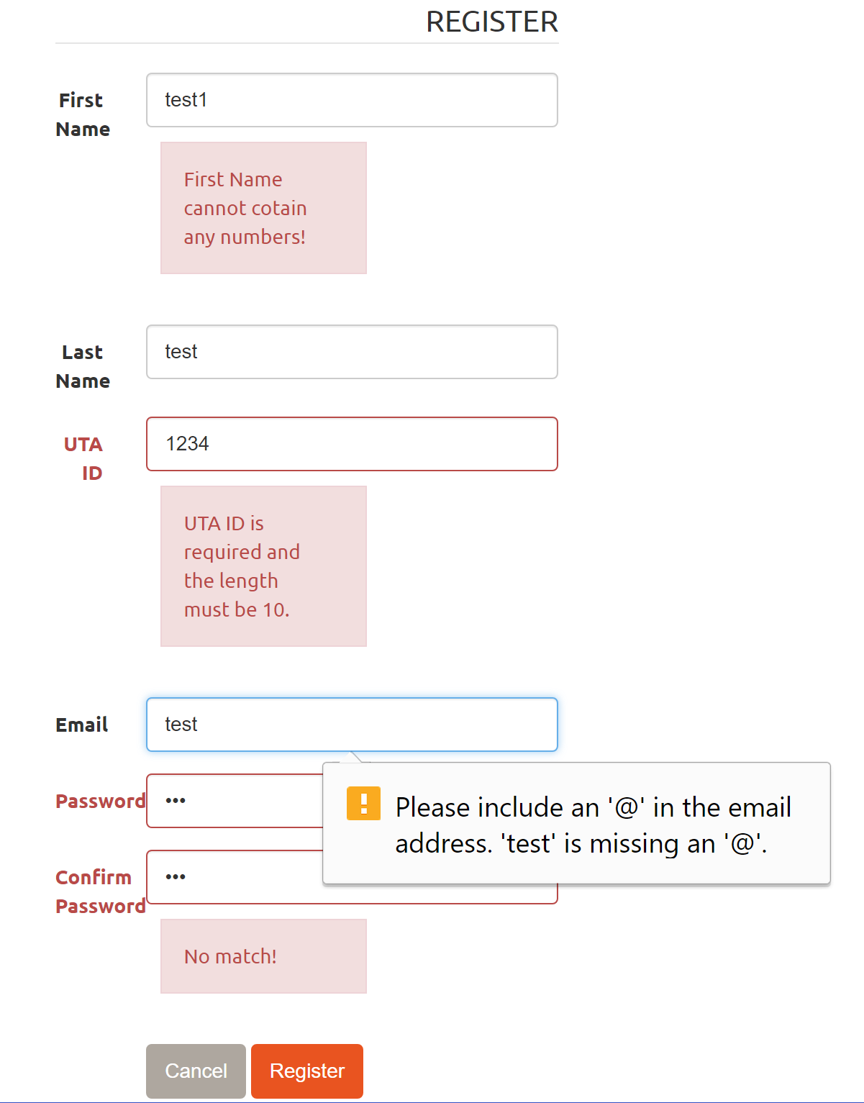
Register With Validations

Slide 9
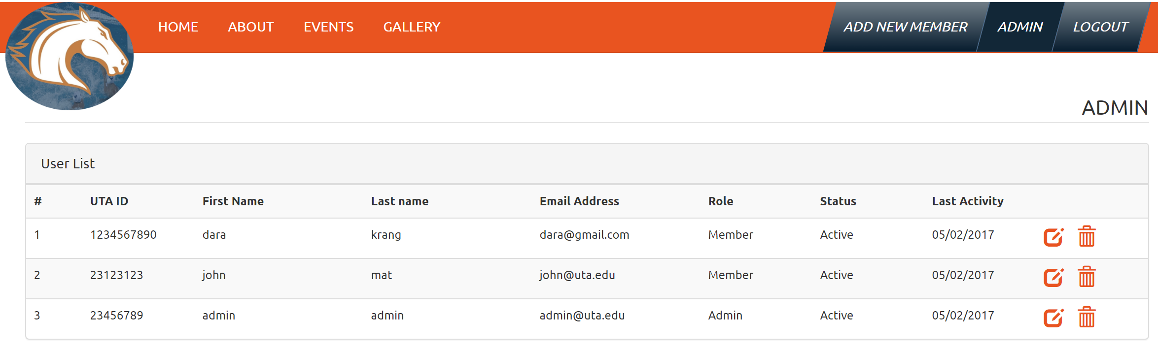
User List

Slide 10
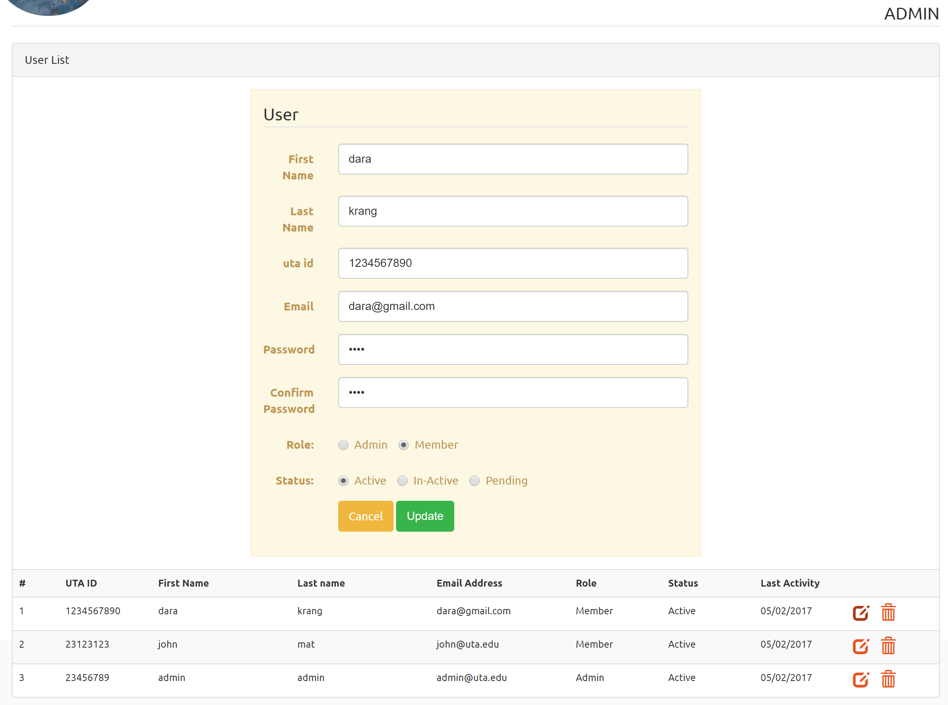
Update User

Slide 11
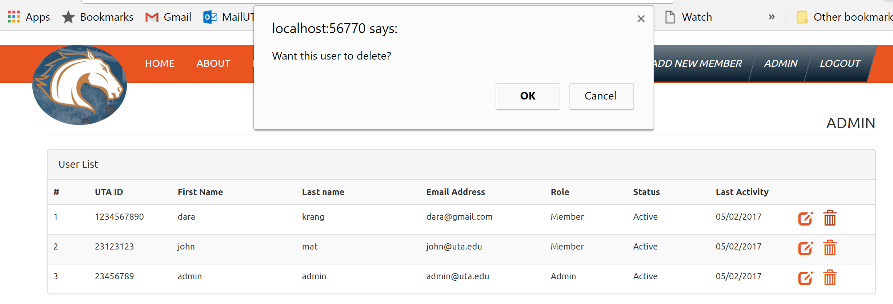
Delete User

Slide 12
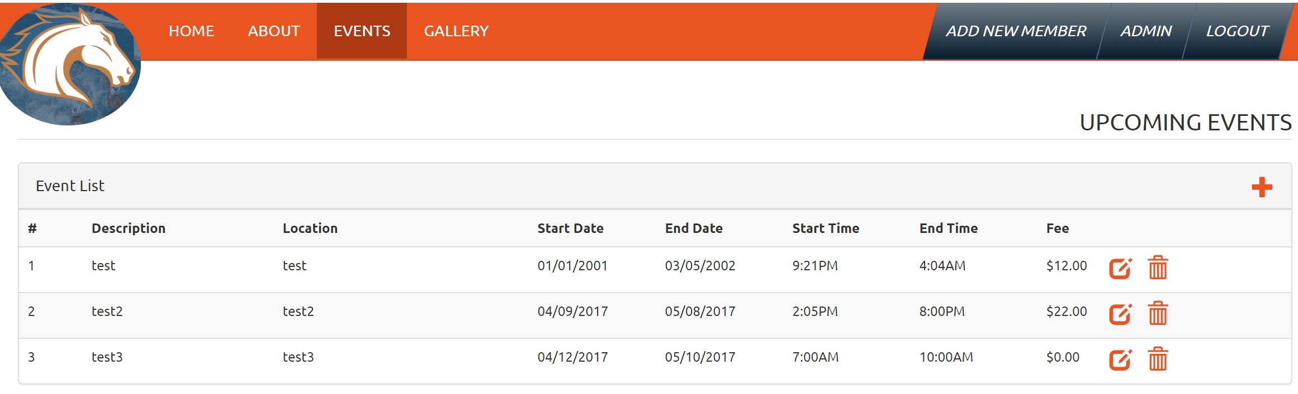
Events

Slide 13
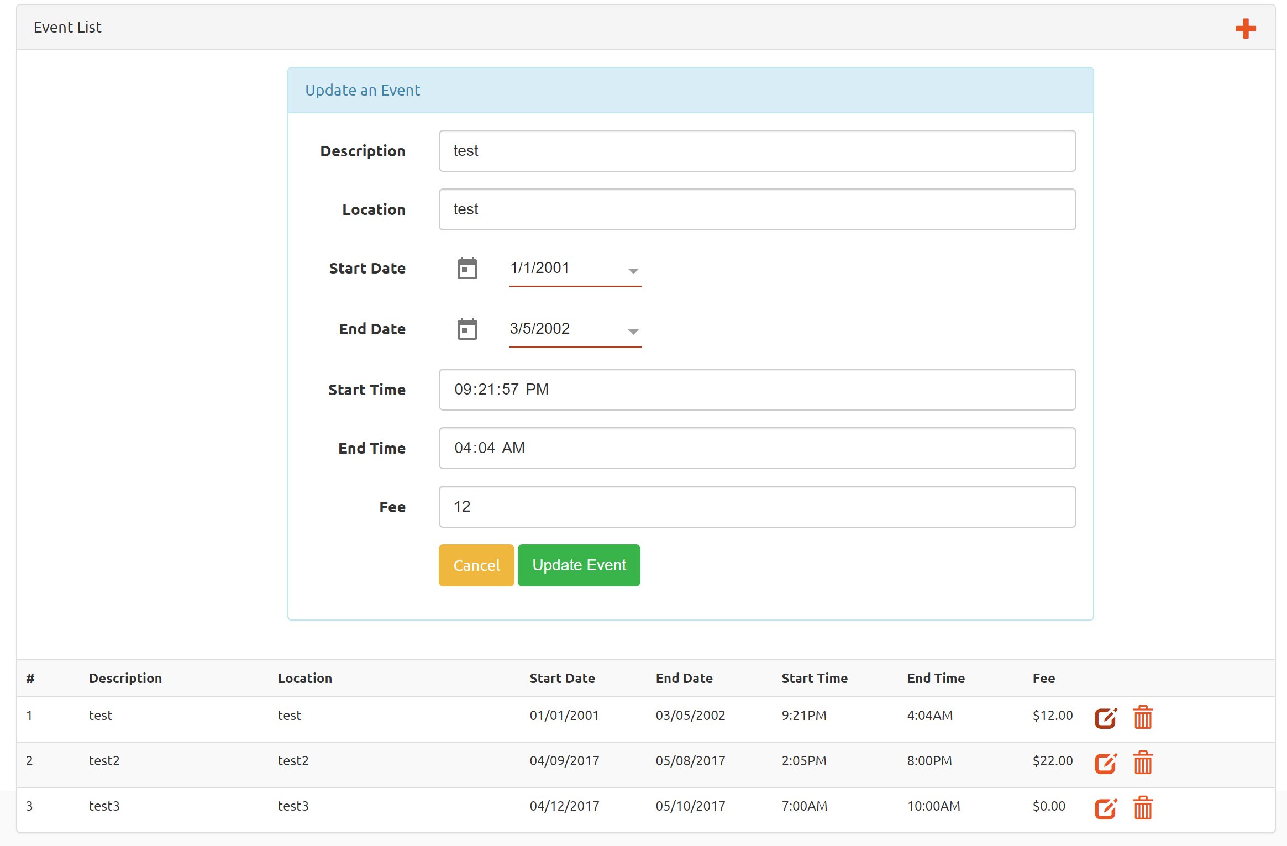
Update Event

Slide 14
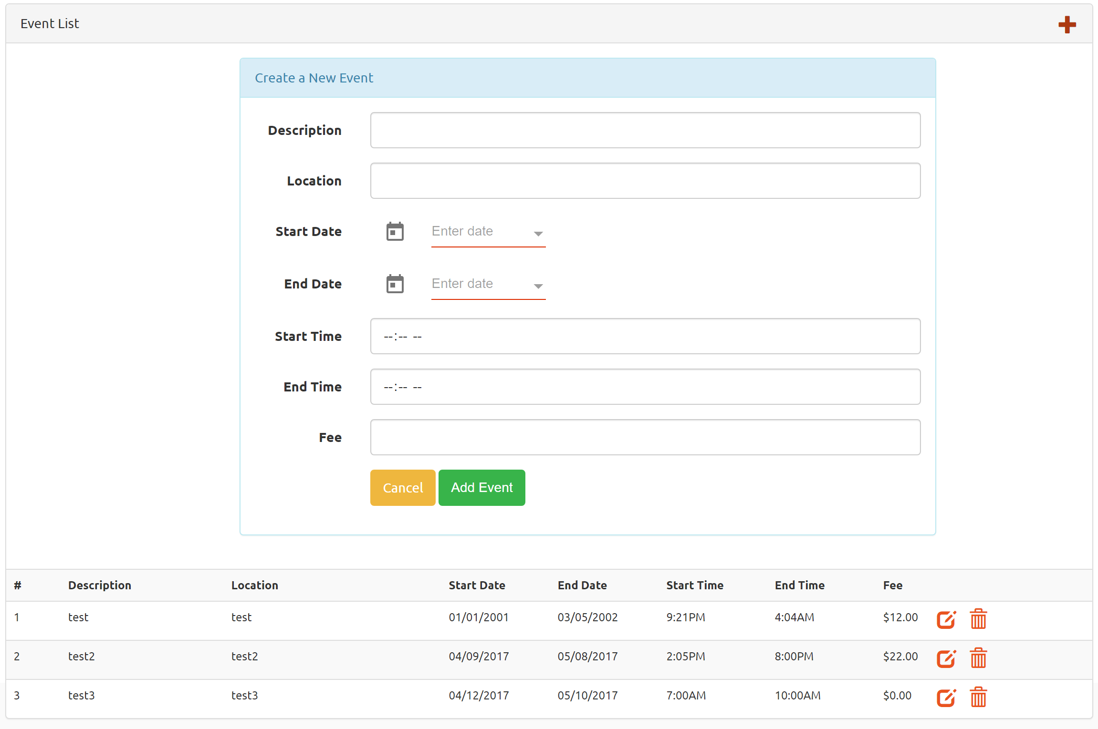
Add Event

Slide 15
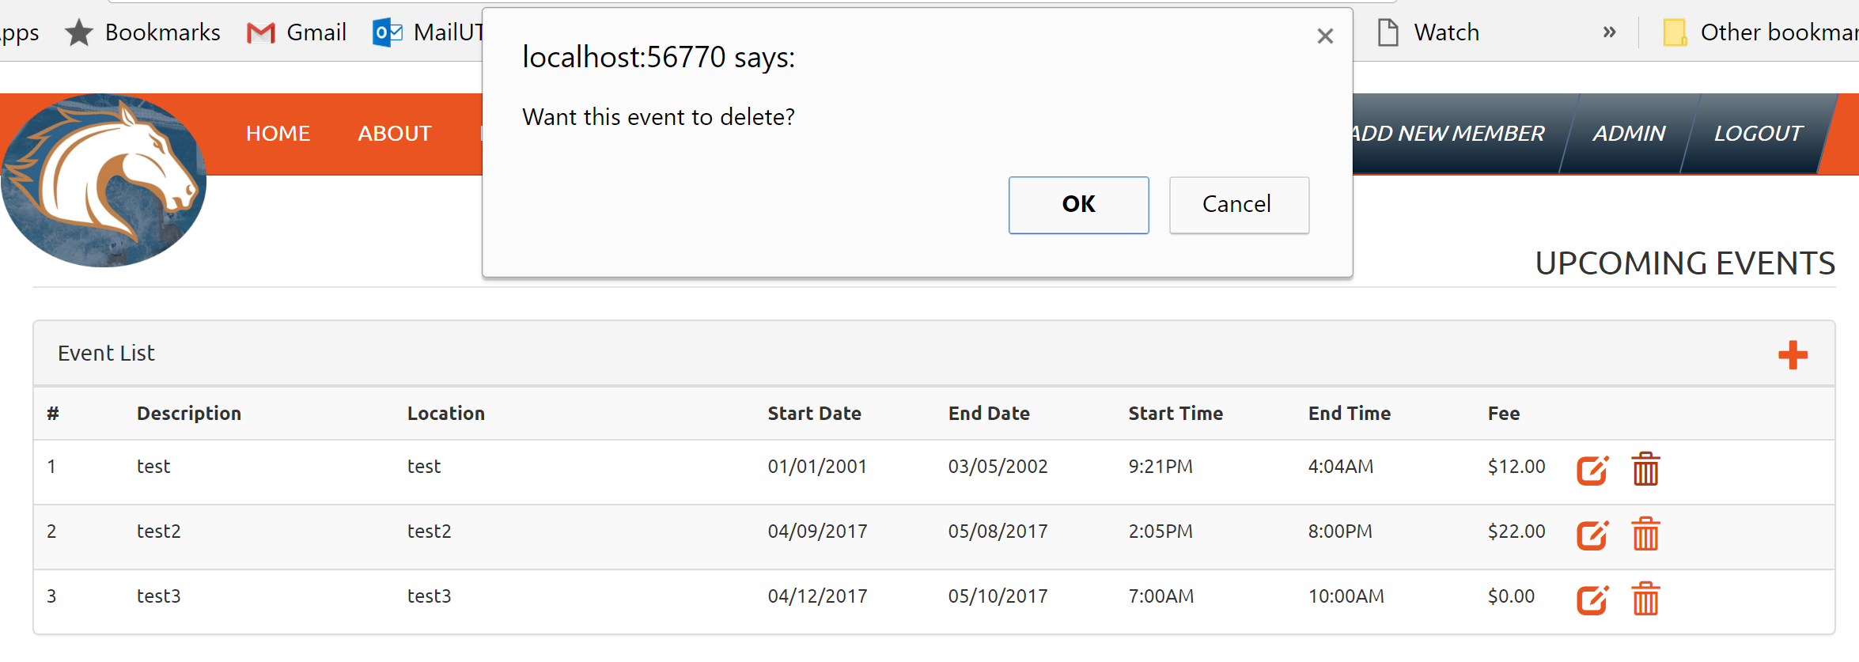
Delete Event

Slide 16
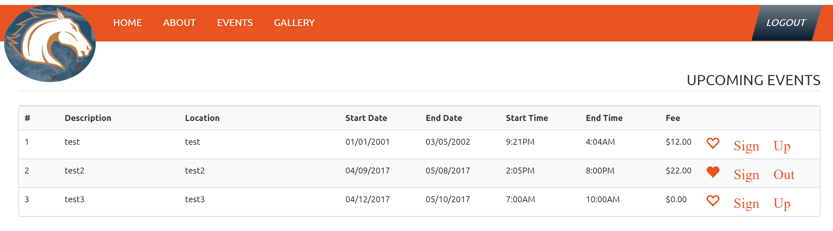
Sign Up Event

Slide 17
Code overview
https://drive.google.com/open?id=0B1Od5YvD0W1kZU04Qk9aZFFLZE0

Slide 18
Demo

Slide 19
Questions?

